Slide 1
Intro to Git
It’s not just file sharing

Slide 2

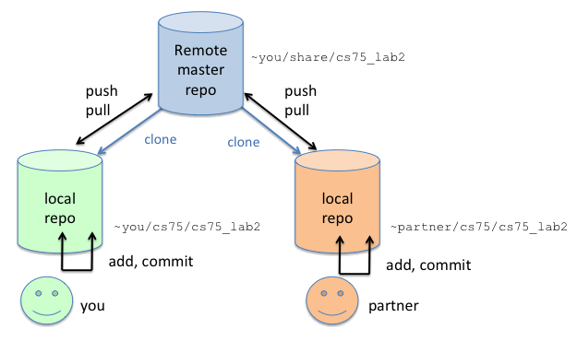
giT iS fOr fiLe sHaRinG
You’re not wrong, you’re just smol brain
Git allows multiple users to share access to the same remote repository and store changes in the same location
Technically this is all you need to know, but we’re still going to go over the actual purpose of version control
Copying remote: git clone <remote url>
Getting other people’s changes: git pull
Sharing your changes: git push

Slide 3
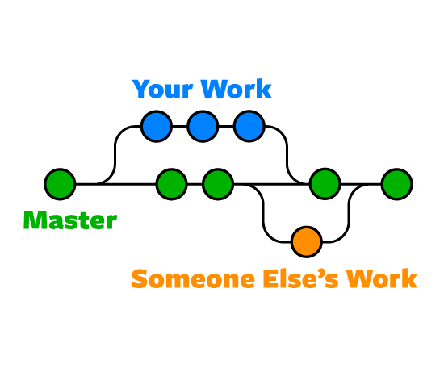
What is Version Control?
Saves entire project state (commit)
Allows different sets of changes starting at the same project state (branching)
Those changes can be integrated back into the main control flow (merging)
Branch
Merge
Commit

Slide 4
Merge Conflicts
> mkdir tmp
> cd tmp
> git init
Initialized empty Git repository in /mnt/c/Users/Atul_Merchia/Desktop/safe/tmp/.git/
> git checkout -b master
Switched to a new branch 'master’
> echo HELLO > test.txt
> git add .
> git commit -m “initial commit”
[master (root-commit) 55d7add] initial commit
1 file changed, 1 insertion(+)
create mode 100644 test.txt
> git branch changeset
Initial Commit
master
### test.txt ###
HELLO
changeset

Slide 5
Merge Conflicts (continued)
> echo CURRENT BRANCH: MASTER > test.txt
> git add .
> git commit -m “made some change”
[master 5ed01b4] made some change
1 file changed, 1 insertion(+)
> git checkout changeset
Switched to branch 'changeset’
> echo CURRENT_BRANCH: CHANGESET
> git add .
> git commit -m “made a slightly different change”
[changeset 7113669] made a slightly different change
1 file changed, 1 insertion(+)
Initial Commit
Made some change
master
### test.txt ###
HELLO
### test.txt ###
HELLO
CURRENT BRANCH: MASTER
Made a slightly different change
changeset
### test.txt ###
HELLO
CURRENT BRANCH: CHANGESET

Slide 6
Merge Conflicts (continued)
> git checkout master
Switched to branch 'master’
> git merge changeset
Auto-merging test.txt
CONFLICT (content): Merge conflict in test.txt
Automatic merge failed; fix conflicts and then commit the result.
MERGE CONFLICT
Made some change
### test.txt ###
HELLO
<<<<<<< HEAD
CURRENT BRANCH: MASTER
=======
CURRENT_BRANCH: CHANGESET
>>>>>>> changeset
Initial Commit
master
### test.txt ###
HELLO
### test.txt ###
HELLO
CURRENT BRANCH: MASTER
Made a slightly different change
changeset
### test.txt ###
HELLO
CURRENT BRANCH: CHANGESET

Slide 7
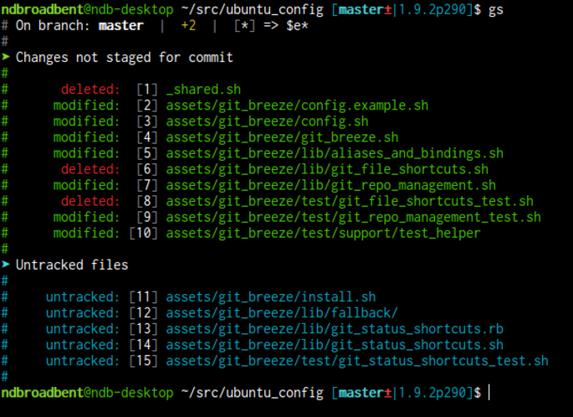
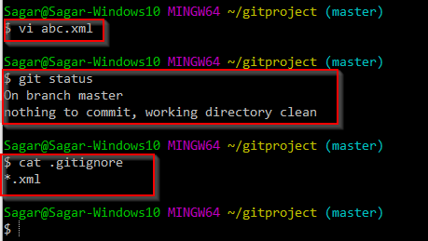
Understanding Local Status
Three possible states
Staged – will be included in next commit
Not staged – has been edited in some way but won’t be committed
Untracked – Git has no idea what’s going on (usually applies to newly created files)
.gitignore file
Git can’t even see files listed in here

Slide 8
Useful Commands
git clone <URL> - Clones repository into folder in current directory with same name as repository.
git fetch - Fetch remote (synchronizes branches)
git pull - Pulling (gets actual changes from remote):
git branch <BRANCH NAME> - Creates a branch. This does not switch to the new branch
git checkout -b <BRANCH NAME> - Creates a new branch AND switches to it
**If branch already exists in remote, simply do git fetch then use git checkout <BRANCH NAME>**
git checkout <BRANCH NAME OR COMMIT HASH> - Changes current branch
git add <FILEPATH OR DIRECTORY> - Mark files that you want to commit
git status - View files marked for commit
git diff <BRANCH NAME OR COMMIT HASH> <FILENAME?> - View changes
git commit - Commit changes. This puts you in a vim-style editor to write your commit message
git commit -m “<COMMIT MESSAGE>” – Shortcut to inline your commit message
git merge <BRANCH> - merges BRANCH into current branch
git push - Push changes to remote
git push --set-upstream origin <BRANCH NAME> - Pushes to new remote branch
Making pull requests - https://github.com/hytech-racing/code-2020/tree/refactored

